Slide 1

Visualition ppt that displays data summary for sprocket central

Slide 2
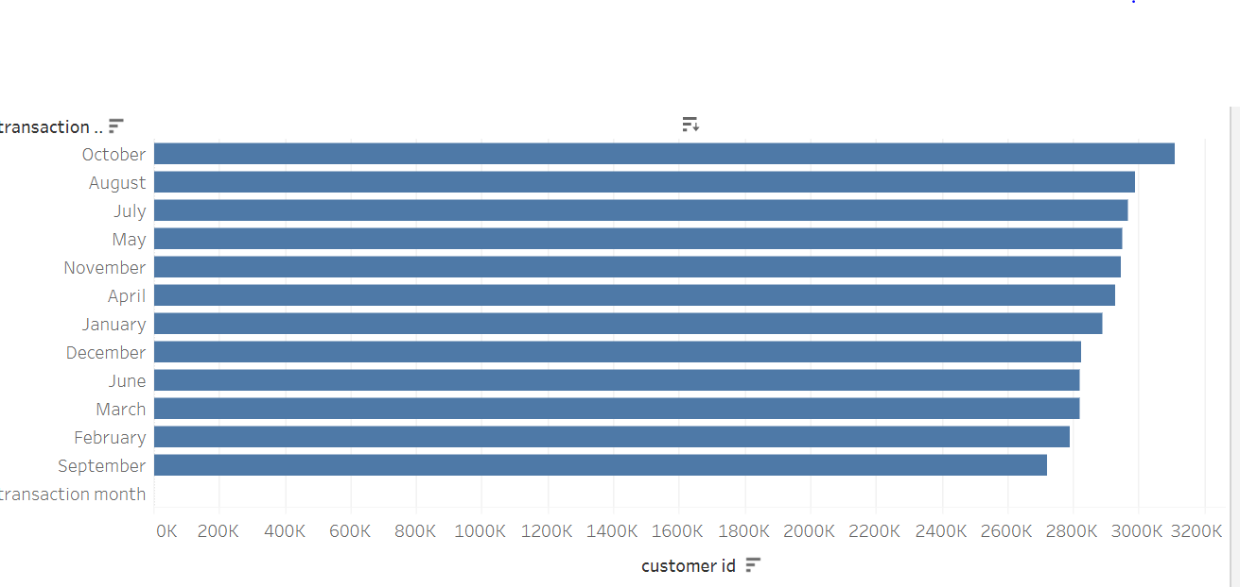
Visualisation of transaction data vs customer id, developed using Tableau

Slide 3
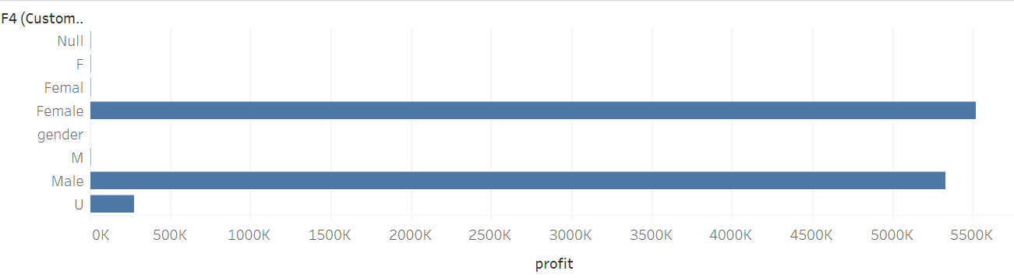
Visualisation of gender vs profit, developed using Tableau

